Slide 1
Module 10: Performing data export using EIM
Siebel EIM training
Notes:
Invoking Enterprise Integration Manager
COMPANY CONFIDENTIAL AND PROPRIETARY INFORMATION — DUPLICATION IS PROHIBITED
35.<number>

Slide 2

Module Objectives
After completing this module you will be able to:
  Understand EIM export process
  Differentiate between EXPORT ALL ROWS and EXPORT MATCHES
  Perform an EIM export
Why you need to know:
  To successfully export data from Siebel base tables.
Notes:
Invoking Enterprise Integration Manager
COMPANY CONFIDENTIAL AND PROPRIETARY INFORMATION — DUPLICATION IS PROHIBITED
35.<number>

Slide 3
EIM Export
Simple process
Reads the data in the Siebel database tables
Places the information in the appropriate EIM tables
Multiple rows generated in EIM (EIM maps multiple base tables)
[You can then copy data from the EIM tables into another database]
No transaction logging
Notes:
Invoking Enterprise Integration Manager
COMPANY CONFIDENTIAL AND PROPRIETARY INFORMATION — DUPLICATION IS PROHIBITED
35.<number>
The export process generally populates the applicable EIM table with a row for every Siebel base table row encountered. As a consequence, where EIM tables have mappings to multiple Siebel base tables, one export operation can generate multiple rows within the EIM table governing the rows encountered within the Siebel base tables.
Transaction logging does not occur during export operations because Siebel base table values are not modified.

Slide 4
EIM Export – Process
Initialize EIM table for export
Apply filter logic to select rows for export
  If EXPORT ALL ROWS is TRUE, ignore any EXPORT MATCHES parameters and export all rows.
  If EXPORT ALL ROWS is FALSE, use EXPORT MATCHES parameters to locate specific rows.
Export child records in corresponding EIM tables
LAST_UPD and CREATED preserved
Notes:
Invoking Enterprise Integration Manager
COMPANY CONFIDENTIAL AND PROPRIETARY INFORMATION — DUPLICATION IS PROHIBITED
35.<number>
The values for the LAST_UPD and CREATED columns in the EIM tables always contain the values for the LAST_UPD and CREATED columns from the target base table. For example, if you use the EIM_CONTACT interface table to export data from the S_CONTACT and S_ADDR_PER base tables, the values of the EIM_CONTACT.LAST_UPD and EIM_CONTACT.CREATED columns contain the data from the S_CONTACT.LAST_UPD and S_CONTACT.CREATED columns, respectively.

Slide 5
EIM Export – Process flow
Prepare Interface Table
Edit Configuration file
Run EIM
Check results
Extract results from EIM table(s)
Notes:
Enterprise Integration Manager
COMPANY CONFIDENTIAL AND PROPRIETARY INFORMATION — DUPLICATION IS PROHIBITED
2.<number>
Positioning Slide

Slide 6
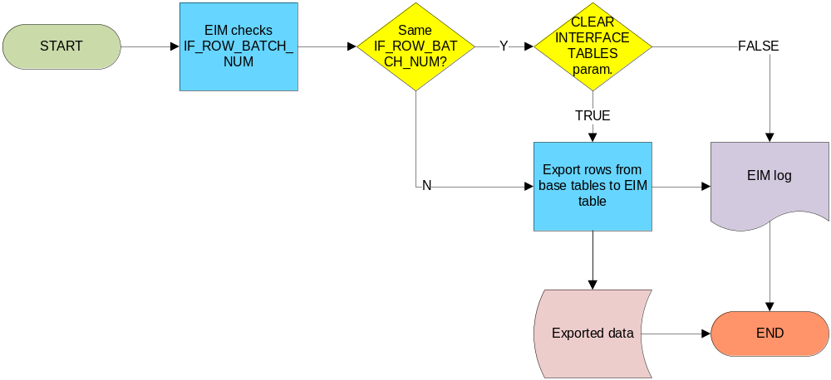
EIM Export – Prepare Interface table
Requires minimal preparation: IF_ROW_BATCH_NUM
IF_ROW_BATCH_NUM checked by EIM
Notes:
Invoking Enterprise Integration Manager
COMPANY CONFIDENTIAL AND PROPRIETARY INFORMATION — DUPLICATION IS PROHIBITED
35.<number>

Slide 7
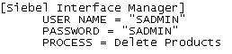

Configuration (.ifb) file
Header Section
Process Section
IF_ROW_BATCH_NUM value to place exported rows
Process type
Exports all rows from target table
EIM table mapping to S_PARTY tables
Notes:
Invoking Enterprise Integration Manager
COMPANY CONFIDENTIAL AND PROPRIETARY INFORMATION — DUPLICATION IS PROHIBITED
35.<number>
This slide annotates an Export configuration file. Example of export process from the S_PARTY table and its extension tables.
NOTE: For performance reasons, you should limit the number of tables to export in a single process section to five or less.

Slide 8
EXPORT MATCHES
Specifies a WHERE clause expression for filtering base table rows.
Used only against a target base table, and works on:
  literal values
  or unqualified column names.
Complex SQL WHERE clauses like subqueries are not supported.
Notes:
Invoking Enterprise Integration Manager
COMPANY CONFIDENTIAL AND PROPRIETARY INFORMATION — DUPLICATION IS PROHIBITED
35.<number>
The expression is a self-contained WHERE clause expression (without the WHERE) and should use
only literal values or unqualified column names from the base table. There must also be a space
separating the operator from the operand.
EXPORT MATCHES can be used only against a target base table, or against a non-target base table
that is an extension table of S_PARTY when the target table is S_PARTY.

Slide 9
EXPORT MATCHES – syntax S_PARTY
Allowed syntax:
  EXPORT MATCHES = S_PARTY, (...criteria...)
  EXPORT MATCHES = <non-target base table name of Siebel Extension type>, (...criteria...)
Not Allowed syntax:
  EXPORT MATCHES = <EIM table name>, (...criteria...)
  EXPORT MATCHES = (...criteria...)
Notes:
Invoking Enterprise Integration Manager
COMPANY CONFIDENTIAL AND PROPRIETARY INFORMATION — DUPLICATION IS PROHIBITED
35.<number>
NOTE: When using the EXPORT MATCHES parameter against a non-target base table, you
must still include the target table in the export.

Slide 10
EXPORT MATCHES – syntax non-S_PARTY
Allowed syntax:
  EXPORT MATCHES = <EIM table name>, (...criteria...)
  EXPORT MATCHES = <target base table name>, (...criteria...)
  EXPORT MATCHES = (...criteria...)
Not Allowed syntax:
  EXPORT MATCHES = <non-target base table name>, (...criteria...)
Notes:
Invoking Enterprise Integration Manager
COMPANY CONFIDENTIAL AND PROPRIETARY INFORMATION — DUPLICATION IS PROHIBITED
35.<number>
NOTE: When using the EXPORT MATCHES parameter against a non-target base table, you
must still include the target table in the export.

Slide 11
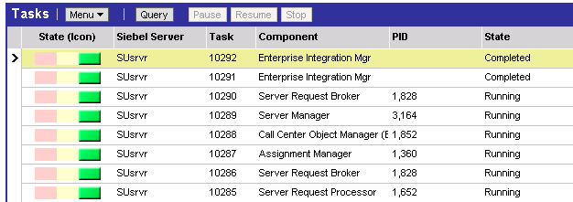
Verify Results
Check EIM process completion
Check EIM table(s) for exported records
Notes:
Invoking Enterprise Integration Manager
COMPANY CONFIDENTIAL AND PROPRIETARY INFORMATION — DUPLICATION IS PROHIBITED
35.<number>
When an export process ends, you should carefully check the results to verify that data was successfully exported. During each export process, EIM writes comprehensive status and diagnostic information to several destinations.

Slide 12
Summary
This module showed you how to:
  Understand EIM export process
  Differentiate between EXPORT ALL ROWS and EXPORT MATCHES
  Perform an EIM export
Notes:
Invoking Enterprise Integration Manager
COMPANY CONFIDENTIAL AND PROPRIETARY INFORMATION — DUPLICATION IS PROHIBITED
35.<number>

Slide 13
Lab
In the lab you will:
  Export all products in Siebel using Enterprise Integration Manager.
Notes:
Invoking Enterprise Integration Manager
COMPANY CONFIDENTIAL AND PROPRIETARY INFORMATION — DUPLICATION IS PROHIBITED
35.<number>
See lab instructions for details.

